Slide 1




Power BI
Manager Guide
Prepared By :
Said Fawzy
Manager of Information Center
Tendering Department
Arab Contractors

Slide 2
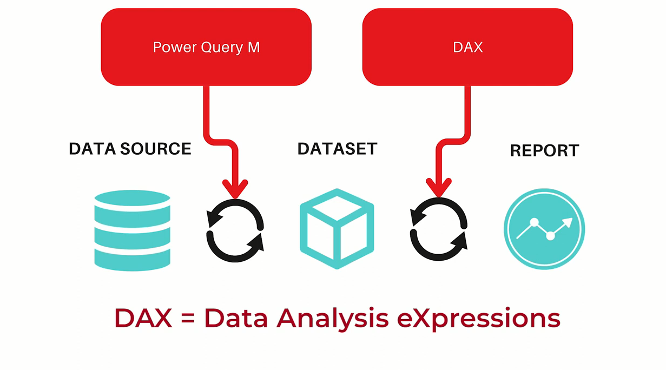
DAX

Slide 3
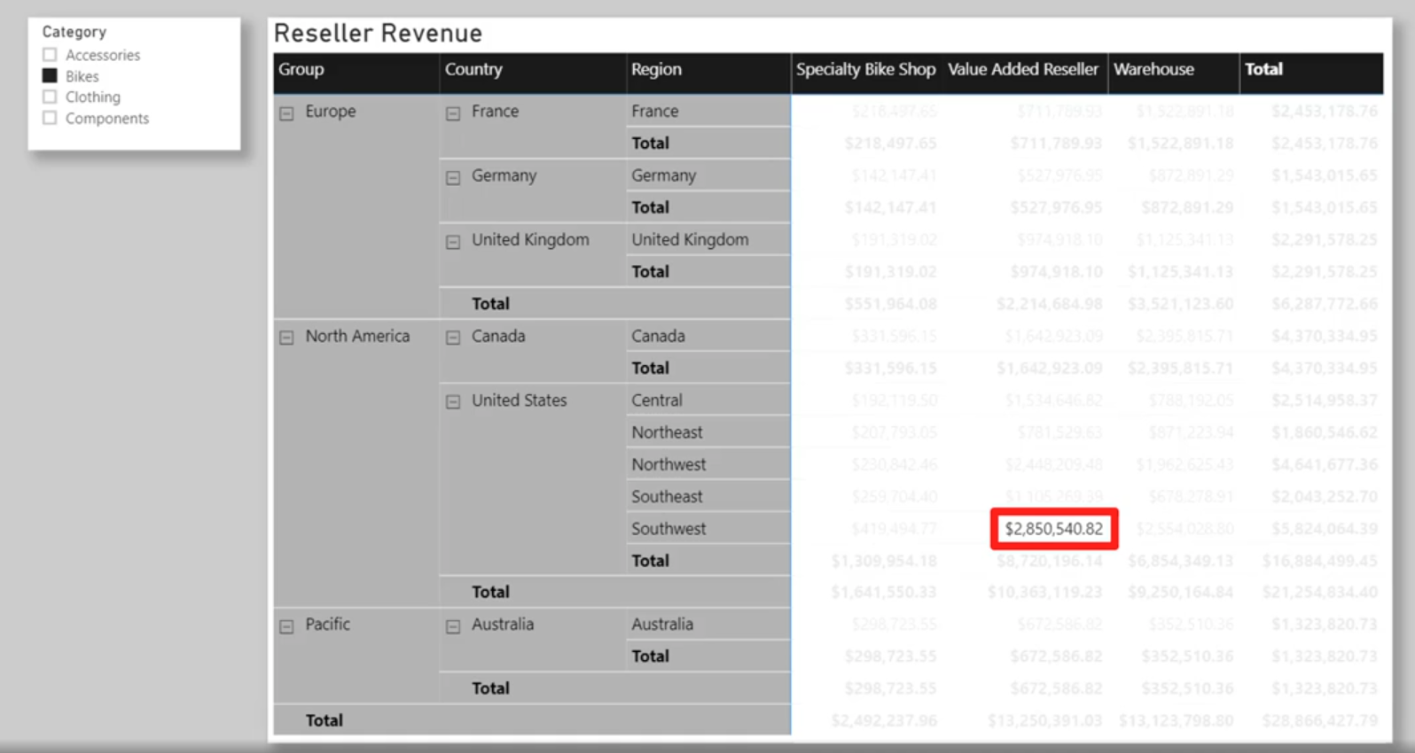
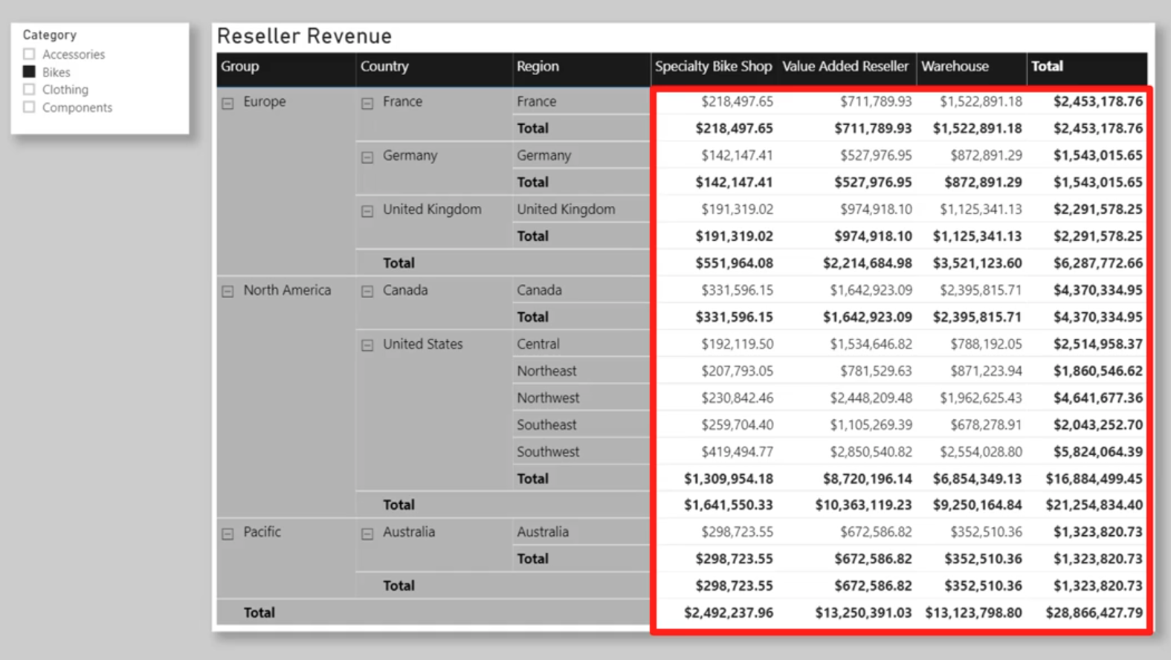
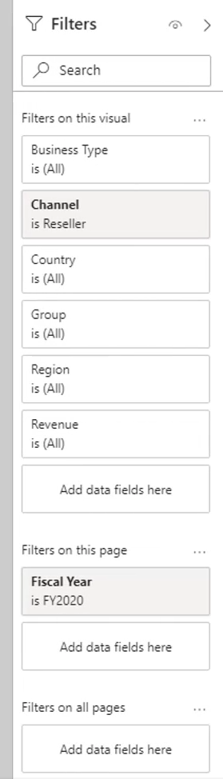

Slide 4
2
Row context and filter context

Slide 5
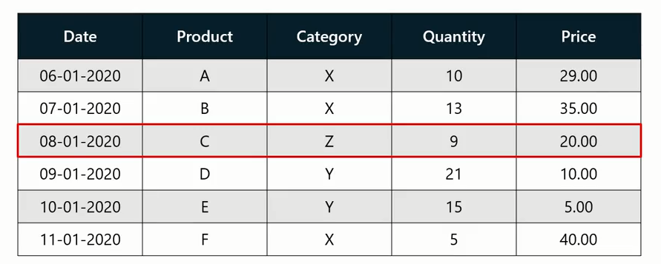
Row Context and Filter Context
What is the total Sales for each Product?
What is the Top Selling Items By Category?

Slide 6
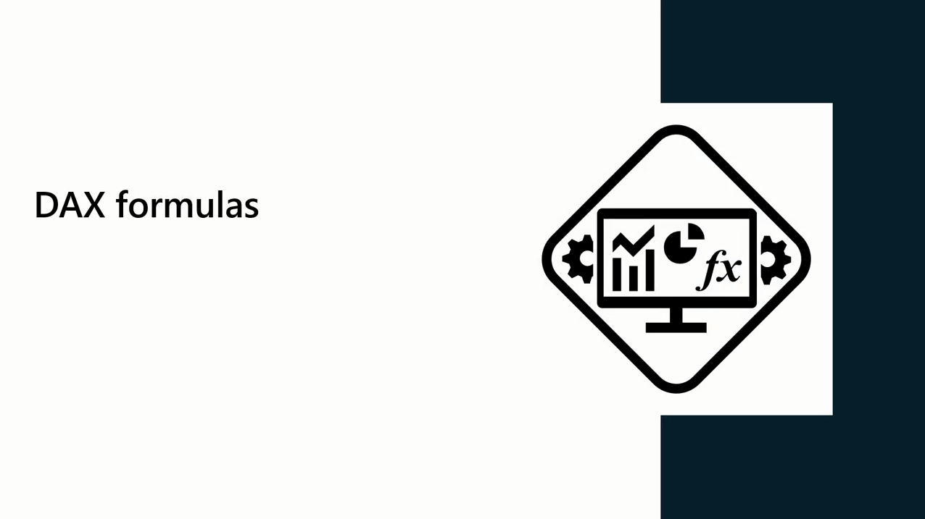
DAX Formulas
DAX computes formulas within a context

Slide 7
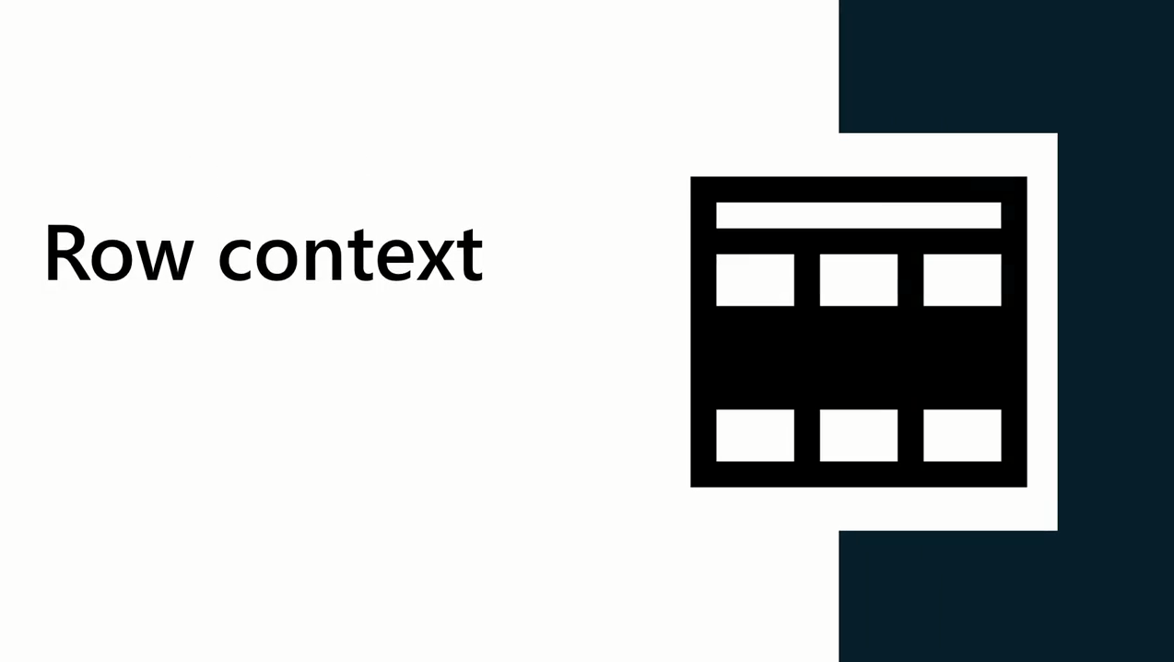
DAX Formulas
Row context refers to the tables current row being evaluated within a calculation

Slide 8



DAX Context

Slide 9
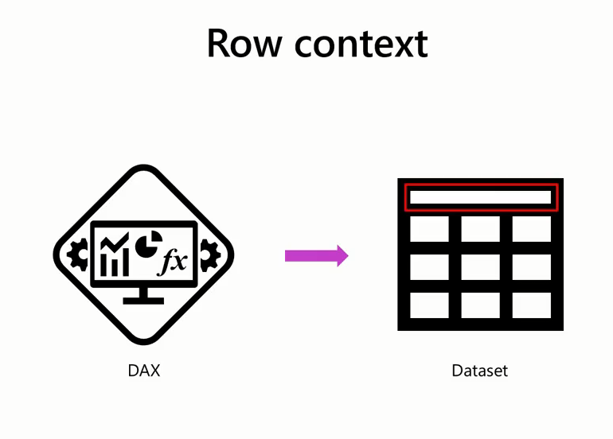
Row Context

Slide 10
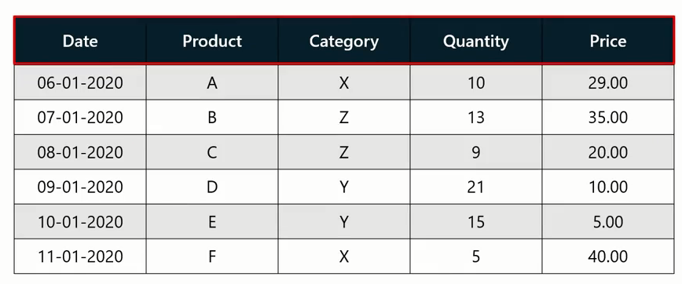
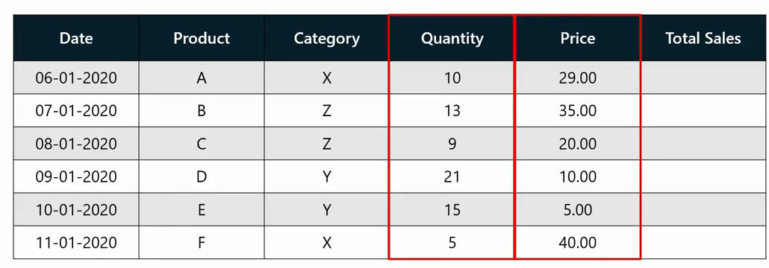
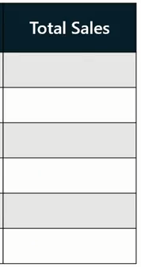
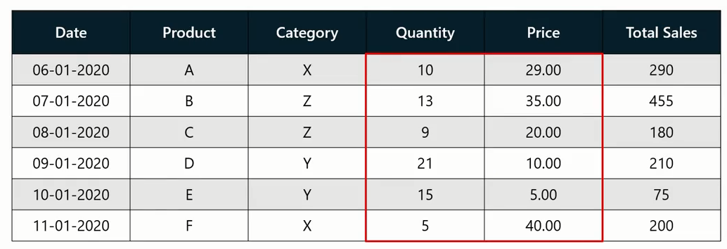
Row Context
What is the total Sales for each Product?

Slide 11
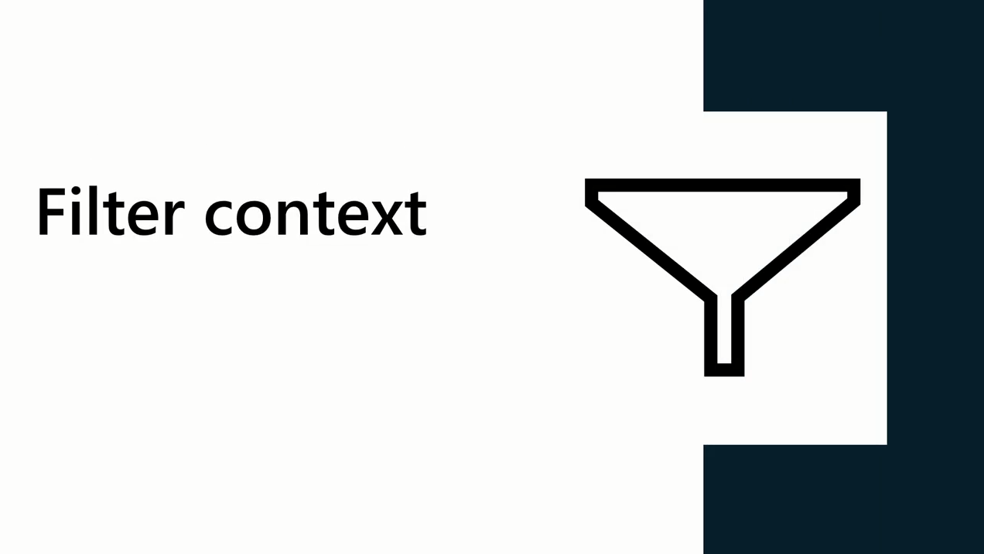
Filter Context

Slide 12

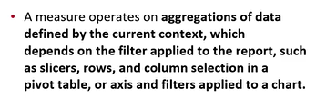

Filter Context

Slide 13
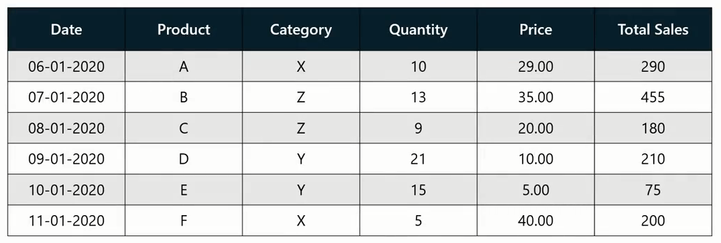
Row Context
In the previous example, a different result was produced in each cell because the same DAX expression was evaluated against different subsets of data

Slide 14
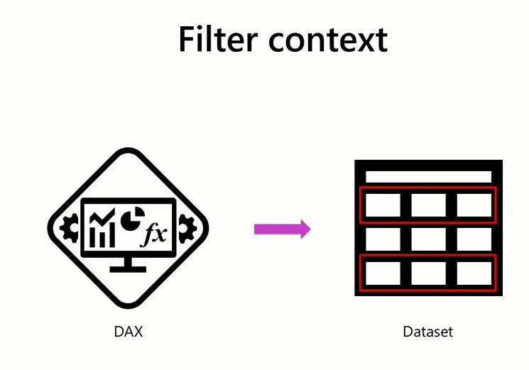
Filter Context

Slide 15
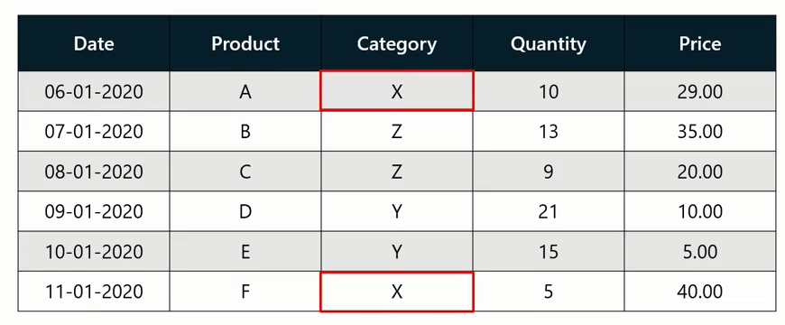
Filter Context
calculate the total sales for all items in Category X

Slide 16
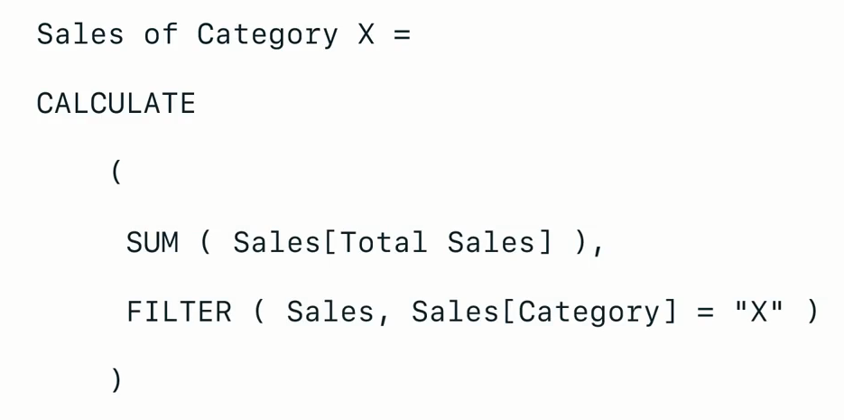
Filter Context

Slide 17
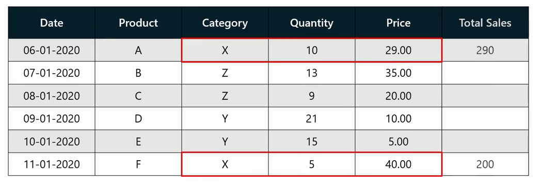
Filter Context

Slide 18
Filter Context
Filter ➔ Calculate
1
2

Slide 19
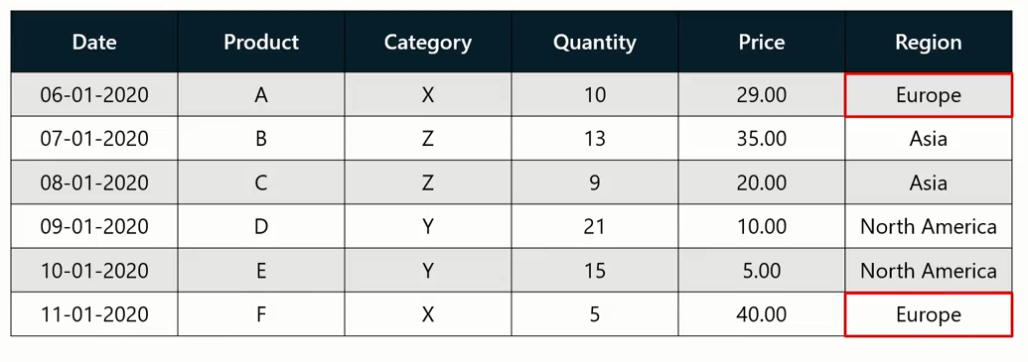
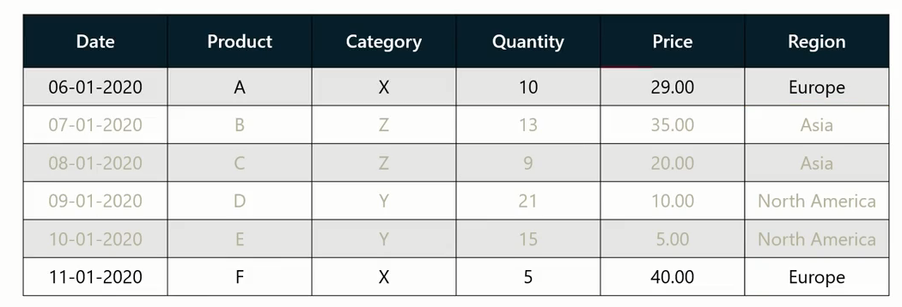
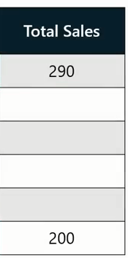
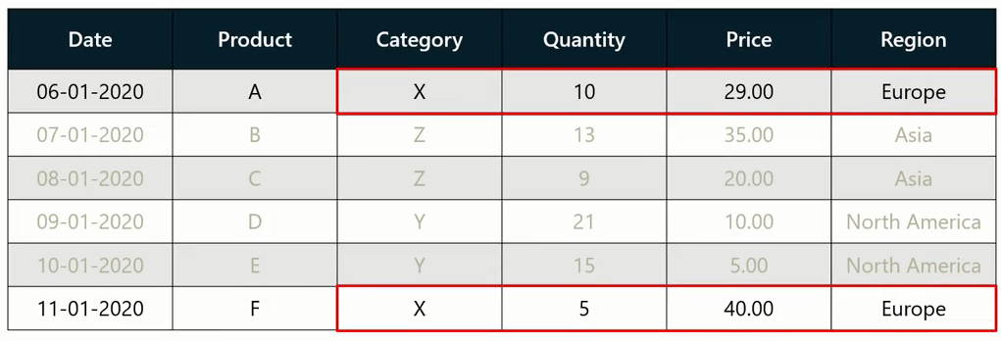
Filter Context
1
Filter
2
Calculate

Slide 20
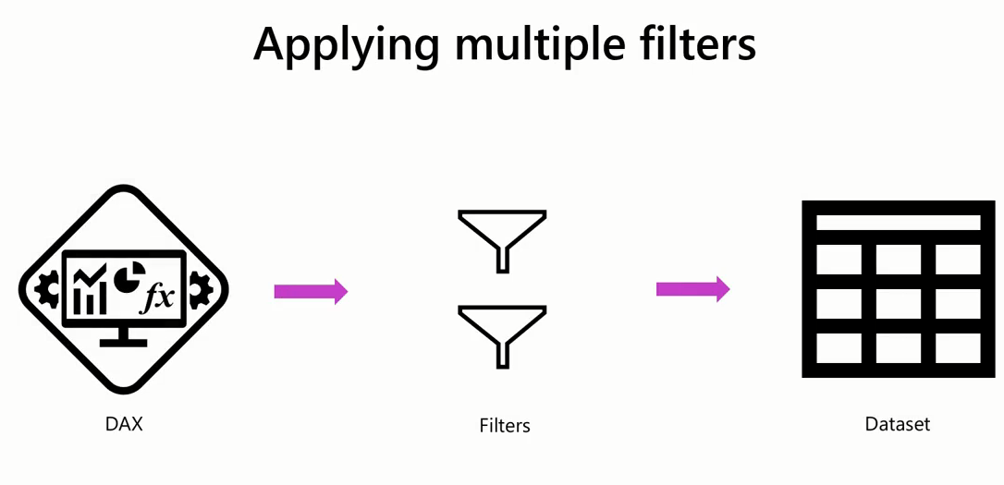
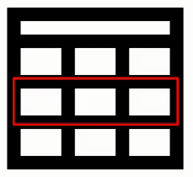
Applying Multiple Filters

Slide 21
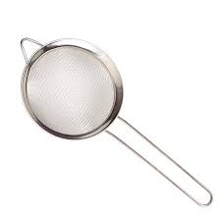
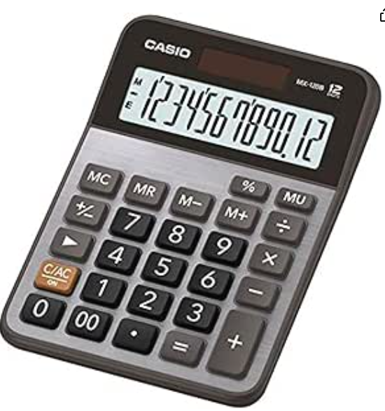
Filter then Calculate
Filter
Calculate

Slide 22
2
Row Context

Slide 23
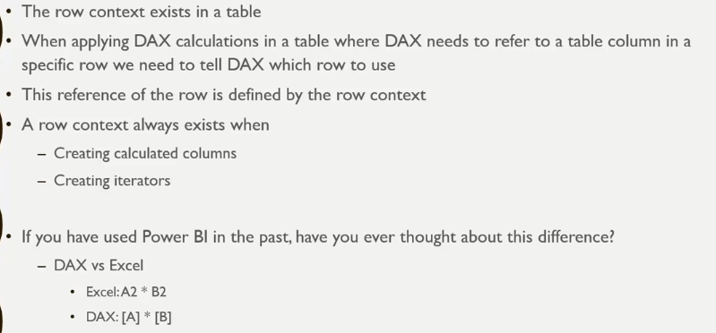
Row Context

Slide 24
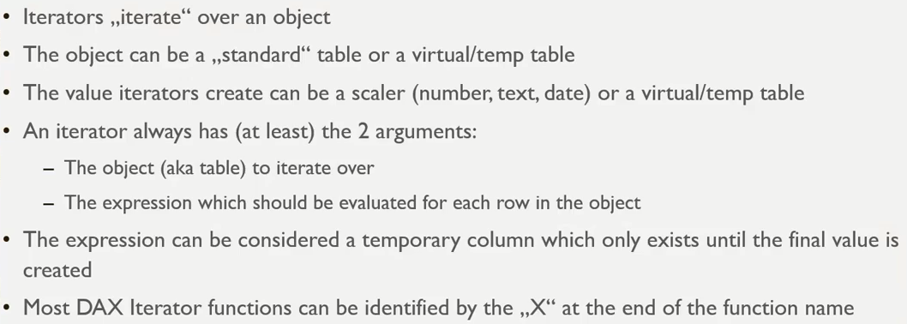
Iterators
Iterators has row context (They iterate row by row)

Slide 25
Iterators
Iterators has row context (They iterate row by row)
Temp/Virtual tables are the one generated in a measure for temporary use. They only exist when the measure needs them to calculate, then removed and never exist in model.
The iterator can return a scaler means one value.
Also, Iterator can return a Virtual/Temp table.
Iterator needs two arguments at least:
  The table to iterate through.
  The expression that will be evaluated row by row.
As the iterator use table and table has Row Context also Iterator has Row Context.
You can consider the expression as a virtual column, it exists until the calculation finished then removed.
Most iterator functions end with the X letter (SUMX, MINX,MAXX……).

Slide 26
Iterators
Iterators has row context (They iterate row by row)
Temp/Virtual tables are the one generated in a measure for temporary use. They only exist when the measure needs them to calculate, then removed and never exist in model.
The iterator can return a scaler means one value.
Also, Iterator can return a Virtual/Temp table.
Iterator needs two arguments at least:
  The table to iterate through.
  The expression that will be evaluated row by row.
As the iterator use table and table has Row Context also Iterator has Row Context.
You can consider the expression as a virtual column, it exists until the calculation finished then removed.
Most iterator functions end with the X letter (SUMX, MINX,MAXX……).

Slide 27
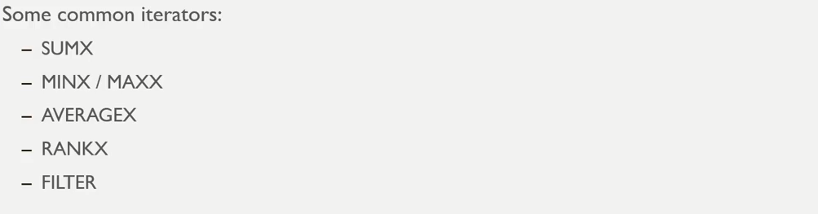
Iterators

Slide 28
3
Filter Context

Slide 29
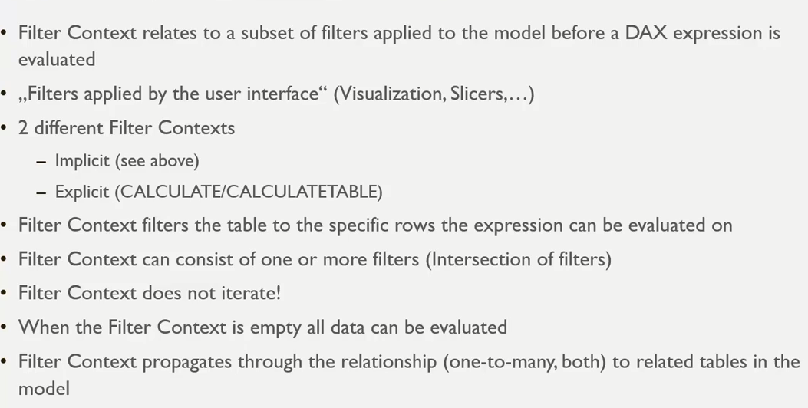
Filter Context

Slide 30
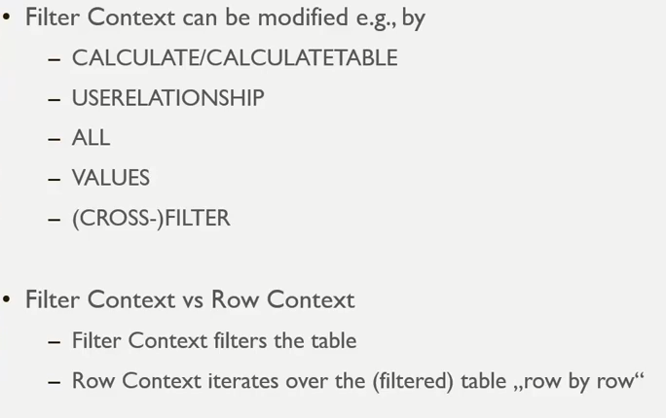
Filter Context

Slide 31


